Slide 1
Recent Developments in Bootstrap Methodology
Nooreen Dabbish
Shinjini Nandi
Daqian Huang

Slide 2
Outline
1. Key ideas
2. Bootstraps for parametric likelihood inference
3. Weighted Nonparametric bootstrapping
4. Subsampling and the m out of n bootstrap
5. Bootstrapping superefficient estimators
6. More on significance tests
7. Bagging and classification
8. Bootstrapping dependent data
9. Other topics and final remarks

Slide 3
3. Weighted Nonparametric bootstrapping

Slide 4
Part 3 outline
1. Several definitions
2. Why use Weighted Nonparametric Bootstrapping
3. How it works
4. One example

Slide 5

1. Several definitions
A. Kullback-Leibler distance

Slide 6



1. Several definitions
B. Prepivoting
F
Random Sample
C_{n}(t) ------ The largest (1-a) th quantile of the distribution of Rn
A ------ The set of all possible values of the parameter

Slide 7

1. Several definitions
B. Prepivoting
Example:

Slide 8

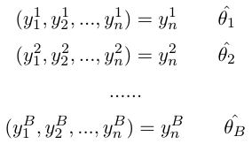


1. Several definitions
B. Prepivoting
replace
The mapping of into by the estimated cumulative distribution function of the former is therefore called prepivoting.

Slide 9
2. Why use Weighted Nonparametric Bootstrapping
Numerical work has shown that both studentized bootstrap and intervals typically show slight undercoverage since occasional instability in the variance estimate V can lead to excessively long intervals.
In order to avoiding this undercoverage, the process of prepivoting was come out.
The main idea is that resampling from a nonuniform distribution with the constraint that

Slide 10


3. How it works
we choose to minimize the Kullback-Leibler distance between

Slide 11
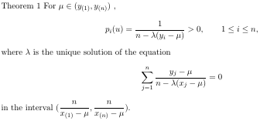
3. How it works

Slide 12

3. How it works
Once we get ,we can use this nonuniform distribution as resampling distribution to do weighted bootstrap sample .
By using prepivoting method, we construct an approximately uniform random variable , a transforming function on u(0,1) .
Then a one-side confidence set for .

Slide 13



3. How it works
The uniform bootstrap estimates the distribution function
Define the prepivoted root
The weighted bootstrap estimates the distribution function
Define the prepivoted root

Slide 14

3. How it works
Lee and Young showed that if u(Y, θ) is uniform to order
Compared to conventional bootstrapping, weighted bootstrap prepivoting accelerates the rate of convergence of the error of the bootstrap inference.

Slide 15
4. One example
R demo.

Slide 16
5. References
[1] LEE, S. M. S. and YOUNG, G. A. (2003). Prepivoting by weighted bootstrap iteration. Biometrika 90 393-410\\ [2] Don H. Johnson and Sinan Sinanovic. Symmetrizing the Kullback-Leibler distance. \\ [3] BERAN, R. J. (1987). Prepivoting to reduce level error of confi- dence sets. Biometrika 74 457-468. \\ [4] A. C. Davison, D. V. Hinkley and G. A. Young (2003) Recent Developments in Bootstrap Methodology. Statistical Science, Vol. 18, 141-157. [5]http://www.ltcc.ac.uk/courses/Empirical\%20Likelihood/Empirical\%20Likelihood\%20notes.pdf

